Slide 1
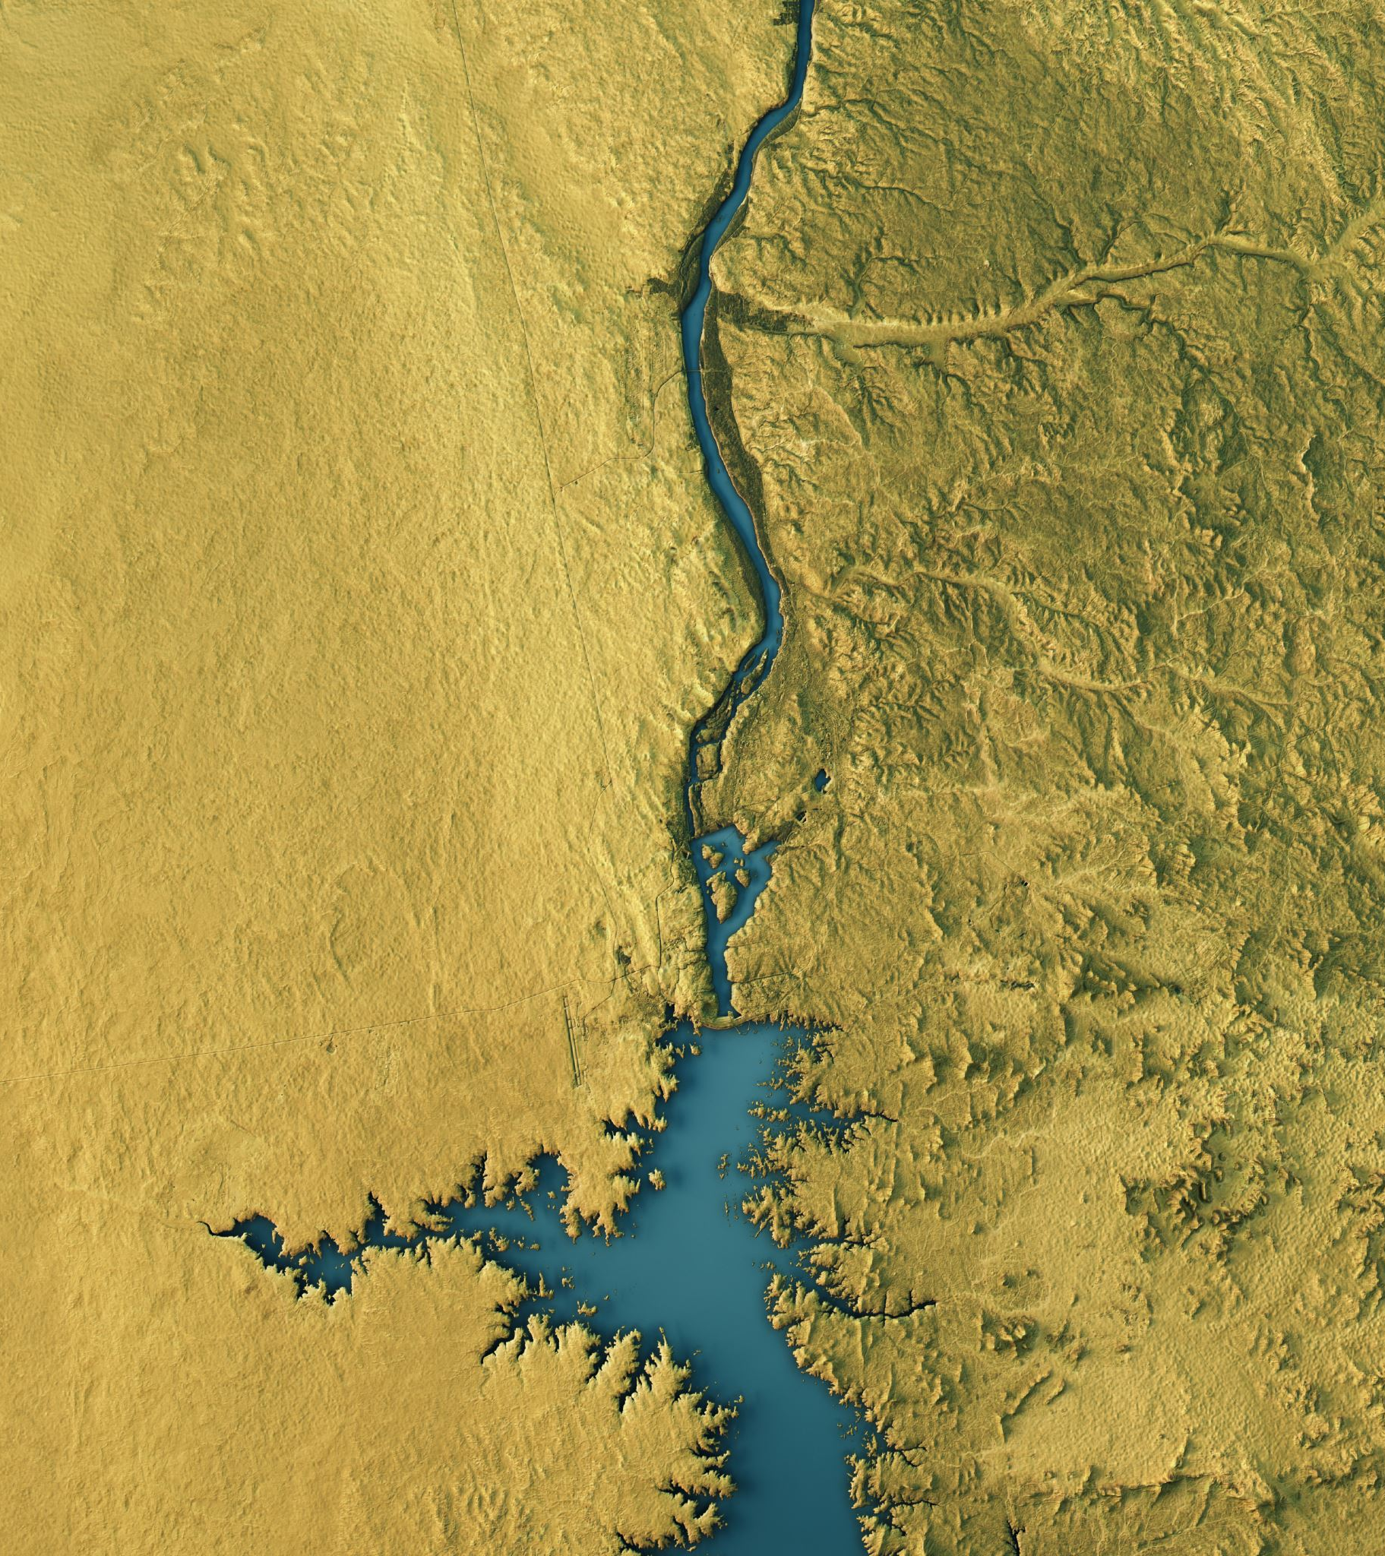
Geographers
Week 5 Thursday

Slide 2
What we have been doing?
Looking at physical and natural environments
Different environments

Slide 3
Today: how can we take care of the environment and places we use?
Our job as geographers:
Raise awareness so people know how to take care of the environment
Know how we use places

Slide 4
An example:
https://www.youtube.com/watch?v=31CdhLMV7Es

Slide 5
What can we do? - https://www.youtube.com/watch?v=xFPoIU5iiYQ

Slide 6
Our school: what can we do!!

Slide 7
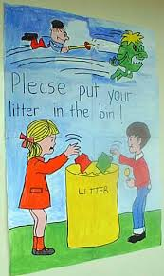
Raise awareness- Design a poster
Title
Caption
Large images
Full of colour
Powerful

