Slide 1
Creating a Path to the Future
A network of educators using Instructional Rounds to enhance student learning
Granville PS
Granville East PS
Granville South PS
Punchbowl PS
Wiley Park PS
Sefton IS
Funded by PSP Regional Initiatives: South Western Sydney
Notes:
Last session – you’re very tired. Hope that by our enthusiasm we can inspire you to at least think about teaching and leadership in a slightly different way and maybe even to establish a network that gives Instructional Rounds a go.
Lucky – energetic team that you’ll be hearing from
Me - Background about why we chose Instructional Rounds & Very brief overview of what Instructional Rounds is & of the beliefs underpinning it – hope that even if you don’t think our way of doing things – Instructional Rounds – is for you – that maybe you can take some of the big ideas, think about them and consider your own practice in the light of them
Chantal - Give an example
Louise & Linda - talk about our journey – what we’ve learnt & what we see as the positives
Hopefully questions at the end

Slide 2
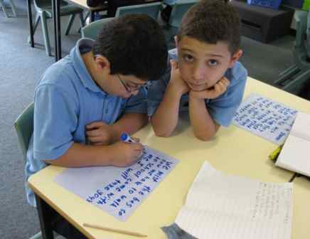
Our Journey – long, exciting, challenging, results-focussed
Notes:
Our journey ……
What comes from this narrative? Important factors
The sense of agency
Network of people with common purpose
The experience and scaffolding of professional conversations, habit of professional reading and viewing
Ability to open up problems to others
“Real team” – commitment to each other and to results
Willingness to take risks.
Slow Knowing- embed theory

Slide 3
Andy Hargreaves, 2006 The Fourth Way of Change The Third Way mid 2000s to now - age of greater professional learning -effervescence towards narrowly defined targets - short-term achievements rather than transformation
The Fourth Way
Age of Inspiration and Sustainability
high quality teachers
powerful professionalism
lively learning communities
The point of networks is to spread innovation, stimulate learning, increase professional motivation, and reduce inequities. They are a fundamental part of The Fourth Way.
Notes:
Positioning schools for the future
Michael Fullan – we’re using the wrong drivers

Slide 4
What is Instructional Rounds? A network approach to improving teaching and learning
network of participants who commit over time
different kind of professional learning
different way of collecting evidence about teaching and learning
a process with defined sequence of activities
Richard Elmore, Harvard Graduate School of Education
Published 2009 – generated much interest
Notes:
In a nutshell – four characteristics

Slide 5
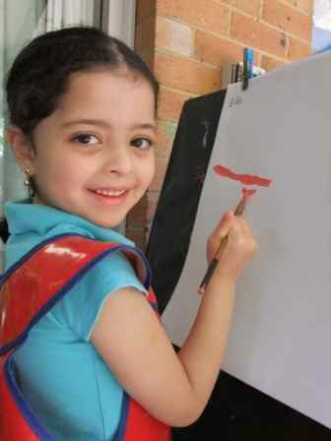
Creating the future is about adopting a mindset, then a passion, then a plan, rather than choosing a path offered by the present. The future is a place we are creating and the task of creating the path forward will change both us and where we are going.
Kember, 2006, Futures Thinking for Leading Learning
Notes:
What’s the best way to go about improving our schools? What kind of evidence is going to best guide us? How can we continue to support each other?

Slide 6
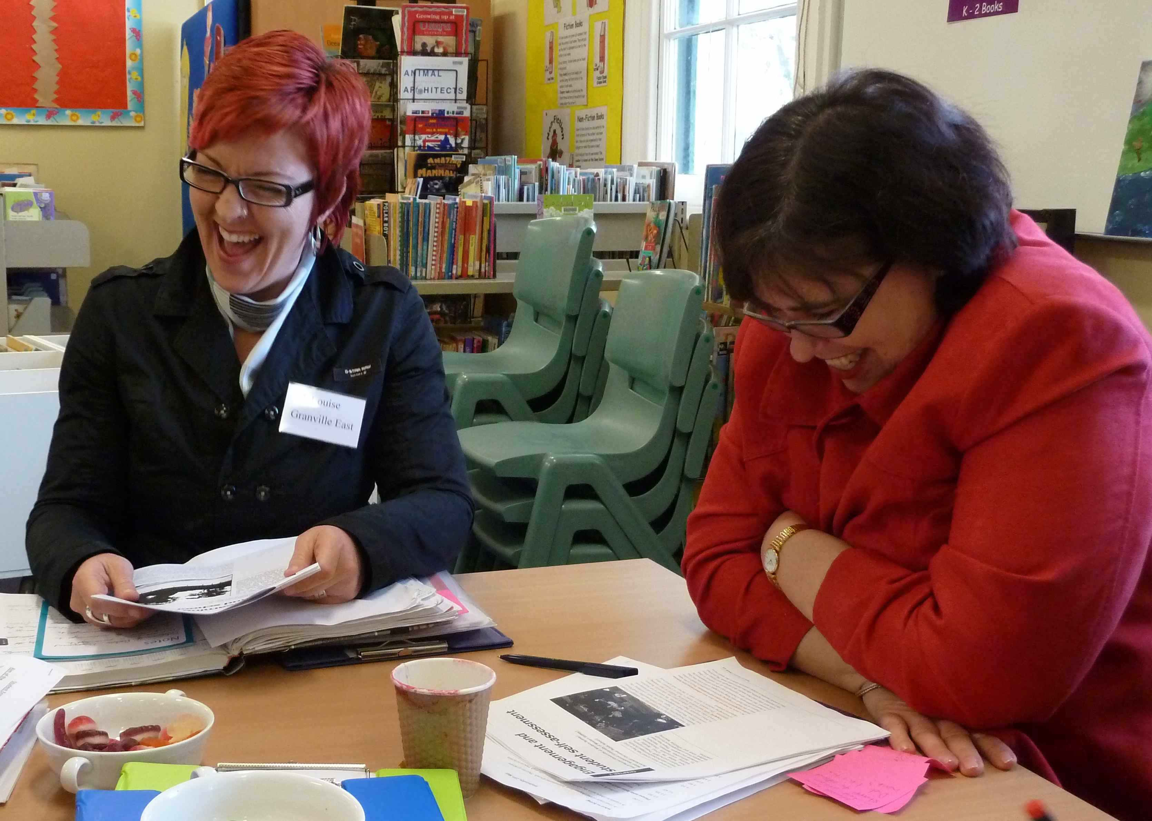
Instructional Rounds
The idea behind instructional rounds is that everyone is involved in working on their practice, everyone is obliged to be knowledgeable about a common task of instructional improvement, and everyone’s practice should be subject to scrutiny, critique and improvement.
You don’t improve schools by giving them bad news about their performance. You improve them by using information about student learning from multiple sources, to find the most promising instructional problems to work on.
Notes:
What are the main ideas behind instructional rounds –two of the big ideas

Slide 7
Underpinned by Beliefs
Increases in student learning occur only as a consequence of improvements in the level of content, teachers’ knowledge and skill, and student engagement.
If you change any single element of the instructional core you change the other two.
If you can’t see it in the core, it’s not there.
The Instructional Core
Student engagement
Level of content
Teacher knowledge and skill
Notes:
Where do you find the promising problems of practice?

Slide 8
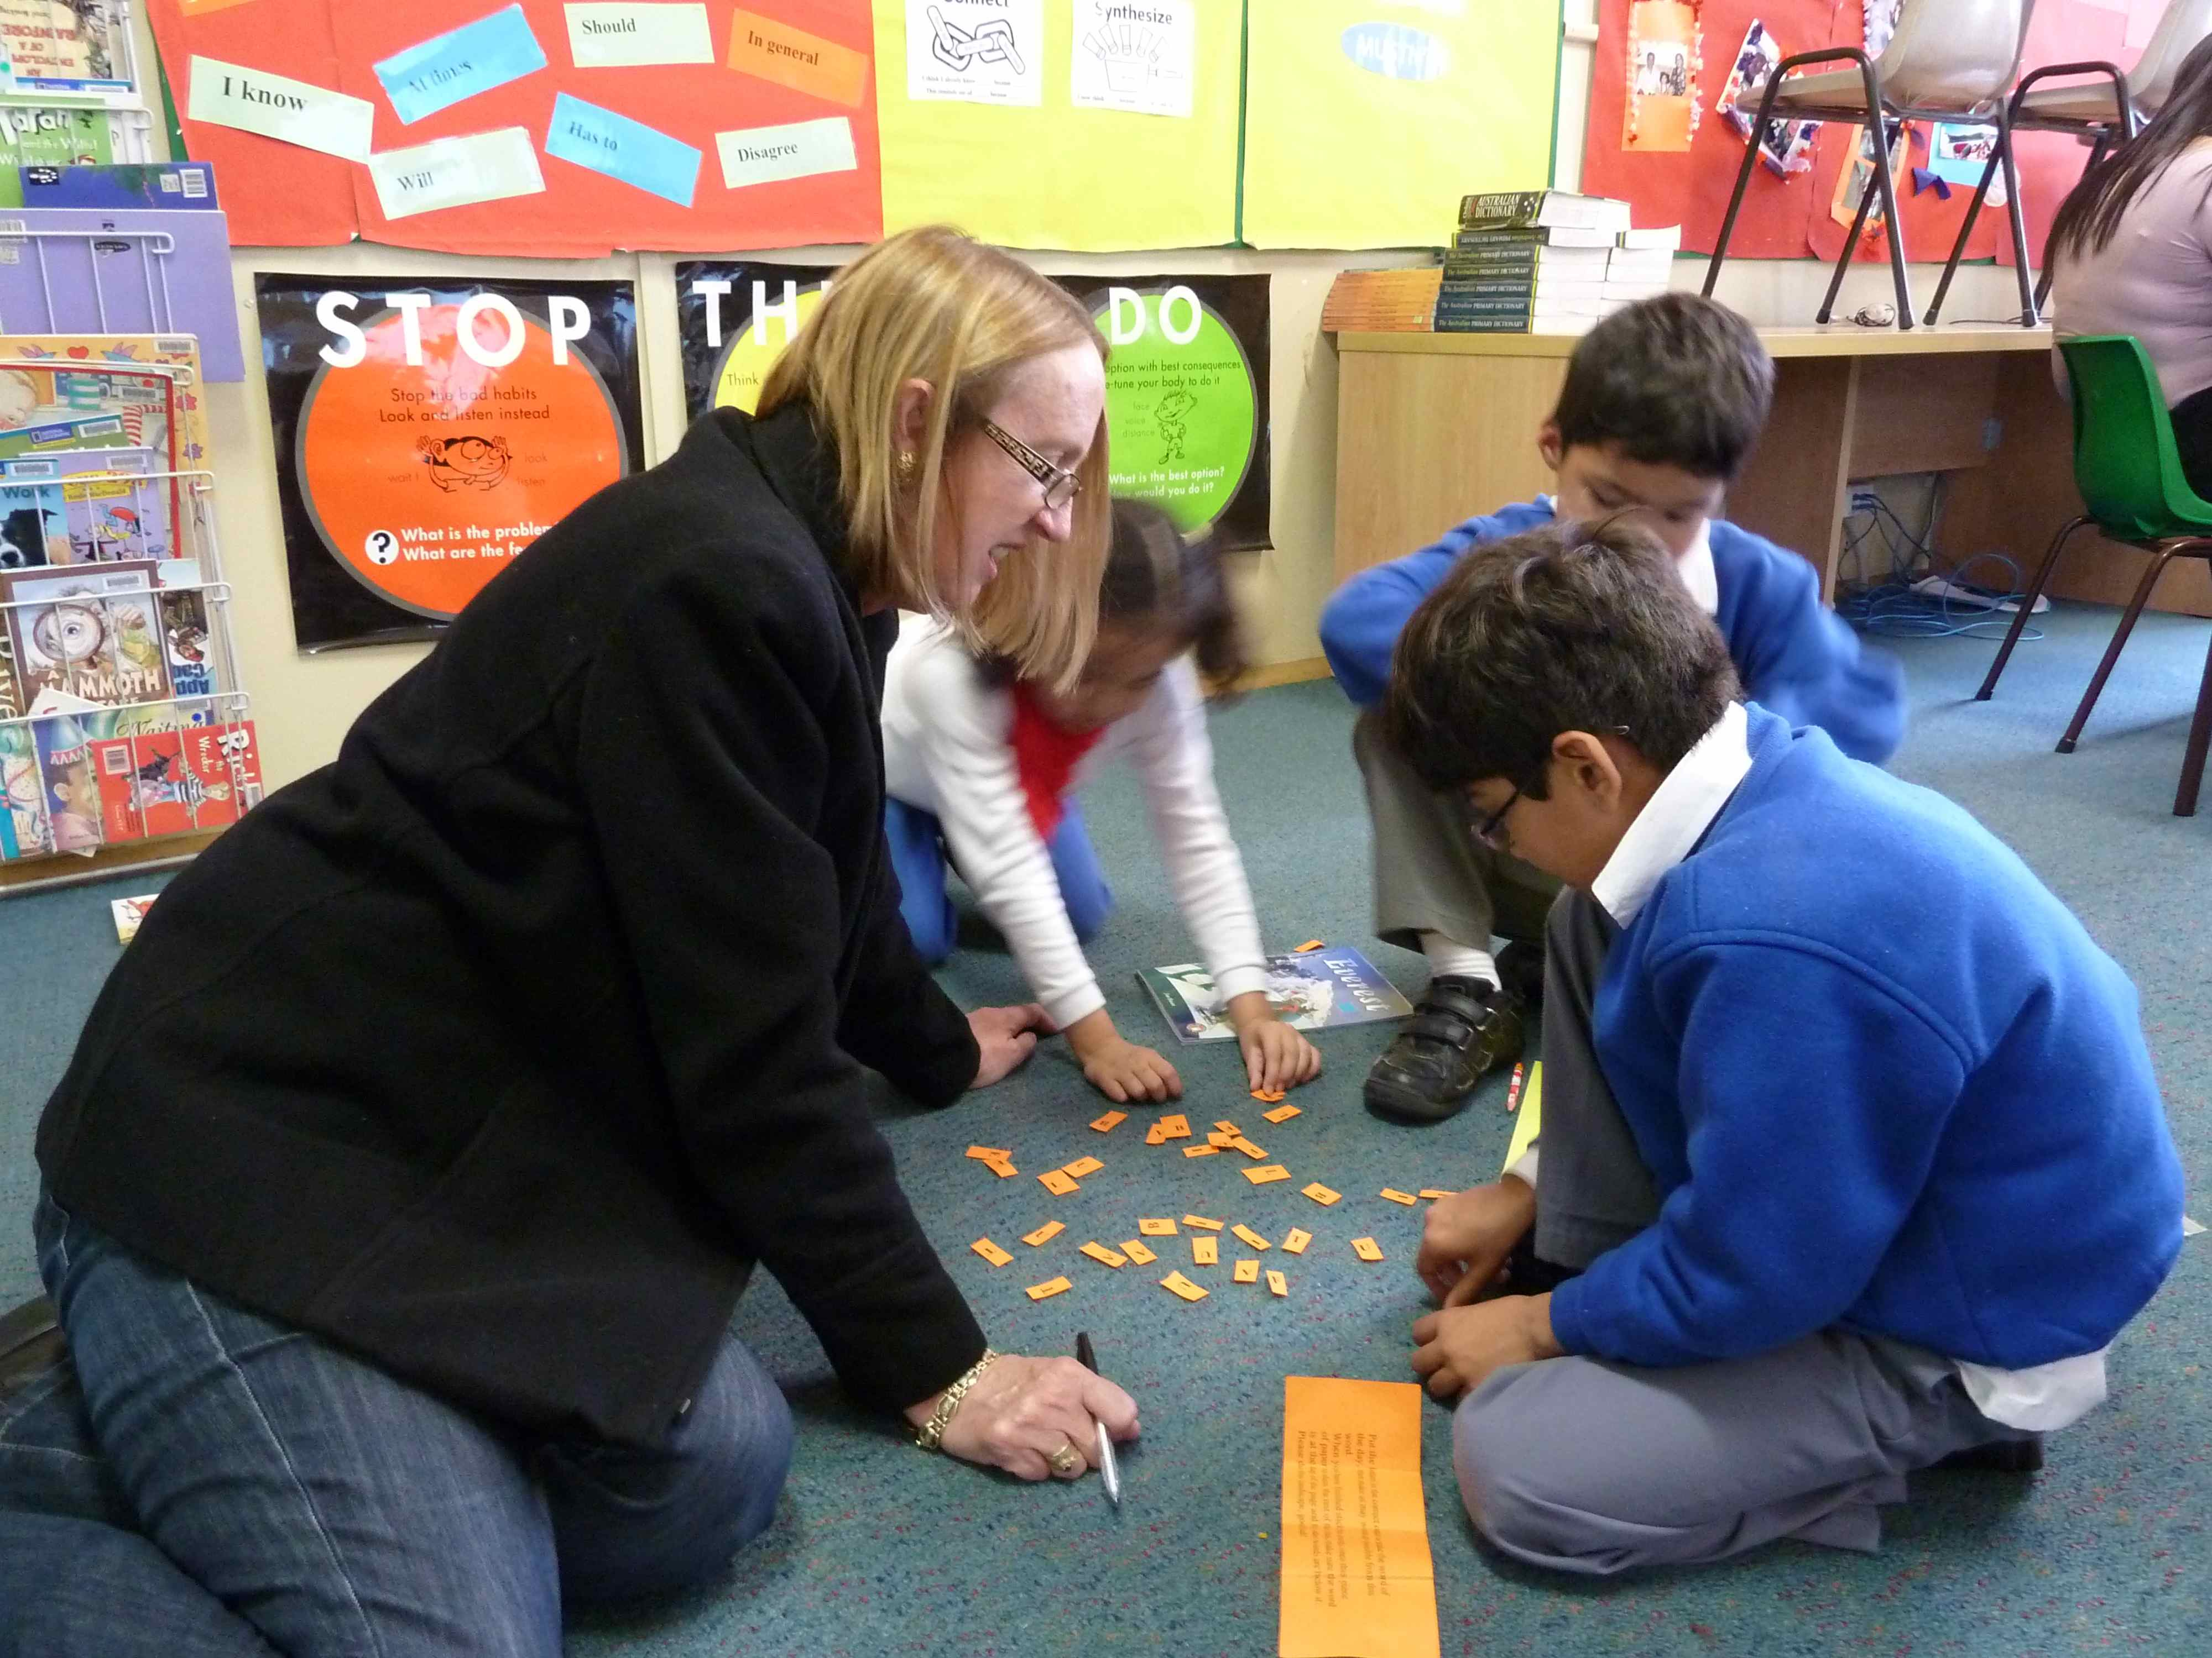
Underpinned by Beliefs
One of the greatest barriers to school improvement is the lack of an agreed-upon definition of what high-quality instruction looks like.
What determines what students know and are able to do is not what the curriculum says they are supposed to do, or even what the teacher thinks he or she is asking the students to do. What predicts performance is what students are actually doing.
Notes:
More big ideas.

Slide 9
New Skills to Learn
The discipline of descriptive observation is the core practice on which rounds is based.
Learning to see, learning to unjudge
Notes:
If we are to look at what students are actually doing then we need new skills.

Slide 10
Each round follows a set format
1. Host school identifies a problem of practice
2. Network explores best practice in that aspect of teaching
3. Observation in classrooms and description without judgement
4. Observational debrief
5. Network proposes next level of work
Notes:
With those big ideas underpinning it, then Instructional Rounds follows a process.

Slide 11
Instructional Rounds
What it is
What it’s not
Process designed to use discussions about learning and teaching as the vehicle for improving school practice
Based on a coherent theory of school improvement
Has its own explicit practice using a set of protocols for observing, analysing and proposing action
A program: it’s a process
Imposed by an outside agency
An avenue for judging the efficiency or quality of individual teachers
Quick fix
Notes:
Finish my section by summarisingul

Slide 12
How it looks – Granville South PS
Granville South Public School – supports the need for creating different paths to the future
School motto: LOOK AHEAD
Built a learning community – watching, listening and learning from each other
Focus is on improved student outcomes and improved teaching = excellent results
All staff are aware of the philosophy – strong instructional rounds team dedicated to the process

Slide 13
Step 1: Host school identifies a problem of practice
Example: Student Engagement
How are students encouraged to think hard?
How are students encouraged to feel good?
How are students encouraged to become better learners?
Focuses on the “instructional core” – relationship between teacher, students & content
Is directly observable
Is actionable – can be improved in real time
Connects to a broader strategy of school improvement

Slide 14
Step 2: Research and Discuss
Example: Student Welfare
Pre-reading – chapters from School is for Me
Articles and videos placed on the creatingapath ning
Input from Barbara – research on student engagement
Input from Chantal – practice related to the MEe framework
Reading and input from an expert in the area
What would be the optimal teaching and learning for this problem of practice?
What would the teachers be saying/ doing?
What would the tasks that are given to students look like?

Slide 15
Step 3: Observation
Observation teams go into classrooms & collect data that is:
descriptive, not evaluative
about the instructional core
related to the problem of practice
May include a specific format for observation note- taking:
What are the students/ saying?
What are the teachers doing/saying?
What is the task?

Slide 16
Step 4: Observation Debrief
If you were a student in this class and did everything the teacher told you to do, what would you know and be able to do?
Observation teams discuss the data:
Describe what you saw
Analyze the descriptive evidence (What patterns do you see?)
Predict what the students will learn

Slide 17
Step 5: Next Level of Work
Group brainstorms the next level of work
Share group resources, professional development and current initiatives
Develop a plan for the next level of work for this week/next month/ by the end of the year
What do teachers need to know to support optimal learning?
What does the school need to know to support optimal learning?

Slide 18
Our Journey – Lessons Learnt
Learning takes time
Learning takes commitment
Learning is deepened by collaboration
Learning needs leadership
Learning needs to stay focused on the Instructional Core
NORMS OF OUR NETWORK
Commitment: Dates are timetabled in advance and everyone attends regularly and comes well-prepared.
Involvement: Every member contributes to all activities, shares expertise and supports others as we move towards common understandings.
Intellectual Rigour: Every member engages in learning that challenges and mystifies. We won’t dumb it down.
Trust and consideration: Every member actively invests in listening, acknowledges differences, and trusts others’ ability to grow.
Openness: Every member is open to new ideas and practices, and honestly expresses opinions.
Confidentiality and respect: Every member maintains confidentiality on sensitive matters and shows respect for the students, teachers and parents in our schools.
Celebration and Laughter: Every member takes opportunities to acknowledge successes – no matter how small – and to share fun and laughter.
Notes:
LOUISE

Slide 19
Keeping in Touch - Ning
Notes:
LOUISE

Slide 21
Benefits of Instructional Rounds
What is worthwhile about Instructional Rounds?
Power of the network;
Provides a school wide picture: snap-shots of a number of classrooms;
Evidence-based data collection;
Professional dialogue: high quality and focused;
Increased professional reading: informed decisions, research based;
Professional learning that is based in a school – therefore in context;
Problem of Practice fosters deep knowledge and deep understanding;
Protocols – keep us focused;
Feedback – about strengths and
recommendations for improvement; and
Is intellectually stimulating.
Notes:
LINDA
What I am presenting this afternoon are the benefits of Instructional Rounds that have been identified by members of our network group.
What is worthwhile about instructional rounds?
The network
This has been extremely powerful – we see our network as a highly effective learning community
The combined knowledge is substantial
We share our knowledge, we learn from each other - from the different perspectives – these are sometimes confirming and sometimes challenging
There is enormous value in visiting classrooms – not only in own schools – but across schools
2. Instructional Rounds provides a school wide picture through snapshots of a number of classrooms – not just one teacher – so we are getting a broader view of where the school is at.
3. It is evidence based data collection
Descriptive data is collected and analysed – not subjective data
4. Professional dialogue is high quality and focused
Different perspectives are explored in depth
Dialogue is about teaching and learning – our core business
5. Increased professional reading
This has lead to informed decision making which is research based
6. In school professional learning
Recent research shows ‘in school’ professional learning to be more effective because it is in the context of the school
7. We gain deep knowledge and understanding about identified aspects of teaching and learning (problem of practice)
8. Use of protocols keeps us focused on the problem of practice
9. We gain valuable feedback
about our strengths
And through recommendations for improvement
10. The whole process is intellectually stimulating

Slide 22
What changes have occurred in our schools?
Professional dialogue at executive level around pedagogy and its complexity;
Professional learning at whole school level;
Increased reflection on our own practice;
Motivation to change practice in own classrooms;
Principals visiting classrooms more frequently;
Principals focus more on teaching and learning;
Greater appreciation of what classroom teachers do daily;
Recommendations taken back to school – shared and implemented; and
Starting to view problems of practice as challenges.
Notes:
What changes have been implemented in our schools as a result of Instructional Rounds?
There has been increased professional dialogue by our executive, around pedagogy and its complexity
The professional learning from instructional rounds sessions is taken back and shared with our whole school
There has been increased reflection on our own practice
There is increased motivation to change practice in own classrooms – a genuine desire for continual improvement
Principals in the network are visiting classrooms more frequently – therefore they have their finger on the pulse
Principals are focused more on teaching and learning – rather than school maintenance and administration issues
There is greater appreciation in our schools of what classroom teachers do daily – the complexities of teaching and learning
Recommendations from the rounds process are shared and implemented in our schools
We are starting to view problems of practice as challenges that can be solved – and this is very exciting

Slide 23
What is the impact on student outcomes?
Student voice is being heard;
Teachers are seeing learning through the eyes of the students;
Increased and improved student/student and student/teacher dialogue; and
Students are becoming more independent learners.
Notes:
What is the impact on student outcomes?
This is the bottom line – as they say in business!

Slide 24
When the profession is guided by good questions, the instructional core is strengthened and we move a few steps closer to wisdom.
Greg Whitby, bluyonder, August 2011

